Slide 1
Project Presentation On “Micro-Credit Defaulter Model” Presented By: Ajit Madame

Slide 2
Agenda
Problem Statement.
Problem Understanding.
What is Micro Credit?
Importance of Micro Credit Defaulter Model.
Exploratory data analysis.
Data cleaning steps.
Data Balancing.
Model Building.
Hyper Parameter Tunning.
ROC Curve.
Saving the model and predictions from saved best model.
Conclusion.

Slide 3
Problem Statement A Microfinance Institution (MFI) is an organization that offers financial services to low income populations. MFS becomes very useful when targeting especially the unbanked poor families living in remote areas with not much sources of income. The Microfinance services (MFS) provided by MFI are Group Loans, Agricultural Loans, Individual Business Loans and so on. Many microfinance institutions (MFI), experts and donors are supporting the idea of using mobile financial services (MFS) which they feel are more convenient and efficient, and cost saving, than the traditional high-touch model used since long for the purpose of delivering microfinance services. Though, the MFI industry is primarily focusing on low income families and are very useful in such areas, the implementation of MFS has been uneven with both significant challenges and successes.

Slide 4
Problem Understanding Telecom Industries understand the importance of communication and how it affects a person’s life, thus, focusing on providing their services and products to low income families and poor customers that can help them in the need of hour. They are collaborating with an MFI to provide micro-credit on mobile balances to be paid back in 5 days. The Consumer is believed to be defaulter if he deviates from the path of paying back the loaned amount within the time duration of 5 days. For the loan amount of 5 (in Indonesian Rupiah), payback amount should be 6 (in Indonesian Rupiah), while, for the loan amount of 10 (in Indonesian Rupiah), the payback amount should be 12 (in Indonesian Rupiah). The sample data is provided to us from our client database. It is hereby given to you for this exercise. In order to improve the selection of customers for the credit, the client wants some predictions that could help them in further investment and improvement in selection of customers. We have to build a model which can be used to predict in terms of a probability for each loan transaction, whether the customer will be paying back the loaned amount within 5 days of insurance of loan. In this case, Label ‘1’ indicates that the loan has been payed i.e. Non- defaulter, while, Label ‘0’ indicates that the loan has not been payed i.e. defaulter.

Slide 5
What is Micro Credit? Microcredit is an extremely small loan given to those who lack a steady source of income, collateral. It is used as a way to obtain a loan, acting as a protection against potential loss for the lender should the borrower default in his payments., or any credit history.

Slide 6
Importance of Micro Credit Defaulter Model Microfinance is important because It provides resources and access to capital to the financially underserved, such as those who are unable to get checking accounts, lines of credit, or loans from traditional banks Poverty alleviation programs provide material, funds, information and project services for people with no income or work opportunities. Because of the credit risks and relatively high costs associated with small loans, the traditional banking system is generally not willing to implement a microcredit system. The borrowers have no collateral to put up against loans and often are refused the needed capital because of the high risk of default. If they resort to underground sources, they are often charged exorbitant interest. This quick fix solution does not address the main structural problem: a lack of proper funding channels

Slide 7
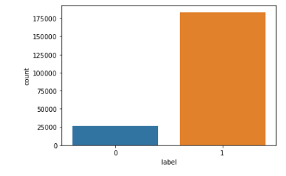
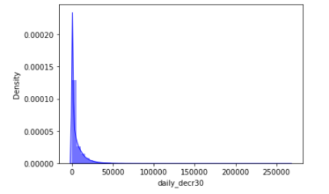
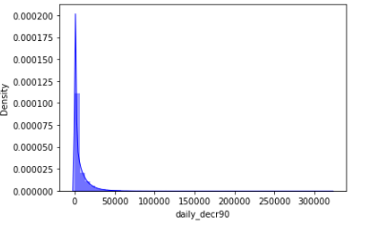
Exploratory data analysis Univariate Analysis Observation # We can see, label is imbalanced so we need to balanced it. So, I will be balanced it in data balancing stage. # daily_decr30 is not normally distributed. It contains some outliers. daily_decr30 is positively or right skewed. # Daily amount spent from main account, averaged over last 90 days (in Indonesian Rupiah) is not normally distributed. Maximum daily amount spent in in the range of 0 to 50000.

Slide 8
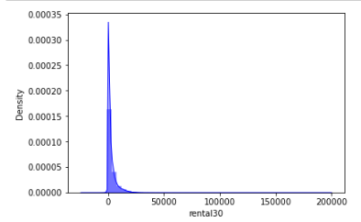
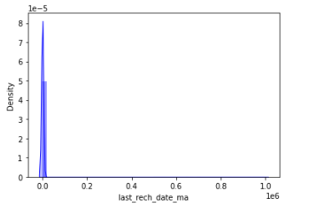
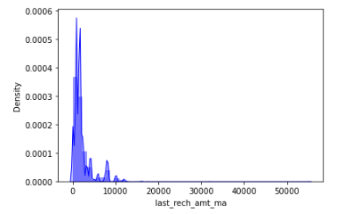
Observation # Average main account balance over last 30 days i.e. rental 30 is in the range of 0 to 50000. maximum rental30 is lies below the 25000. rental is not a normally distributed. # Maximum Number of days till last recharge of main account lie in the range of 0 to 0.2. But mostly the data are containing 0.0. # Amount of last recharge of main account is in the range of 0 to 10000. But Maximum data is lies in below 6000. Data is not normally distributed. It is right or positively skewed.

Slide 9
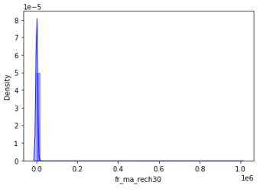
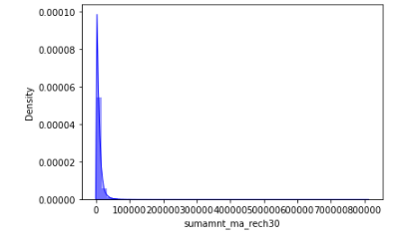
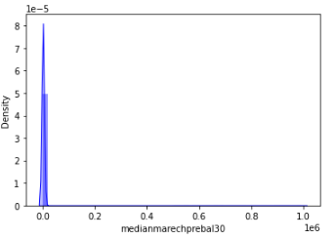
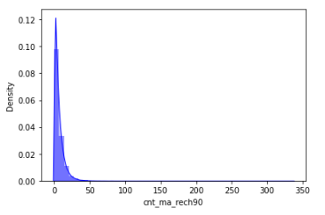
Observation # We can see, almost to time Frequency of main account recharged in last 30 days. # Less than 50000 time the Total amount of recharge in main account over last 30 days is happened. # 0 is a Median of main account balance just before recharge in last 30 days at user level. We can see, 0 is median where the users are doing recharge in last 30 days. # We can see less 30 Number of times main account got recharged in last 90 days. It has very high count than others. It shows positively skewed.

Slide 10
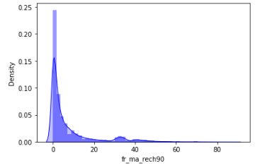
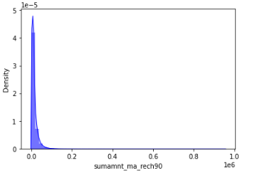
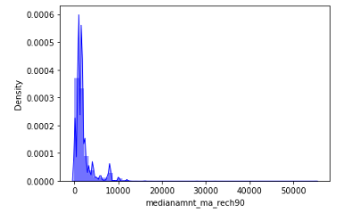
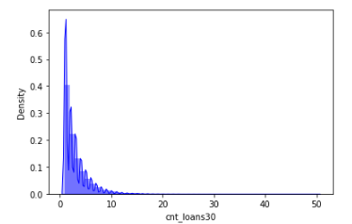
Observation: # We can see the users are doing less than 20 time the Frequency of main account recharged in last 90 days. it shows that users are not interested. # We can see. less than 1.5 Total amount of recharge in main account over last 90 days. # Less than 10000 Median of number of recharges done in main account over last 90 days at user level. We can see, users are taking less than 10 Number of loans taken by user in last 30 days. I show that users are taking # less than 10 loans but mostly the users are taking up to 5 loans in last 30 days.

Slide 11
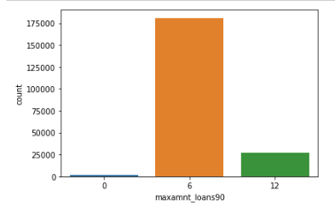
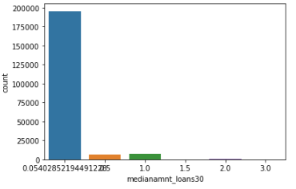
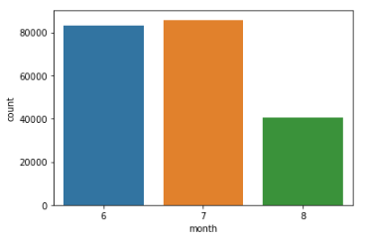
Observation # We can see user are taking loans are less than 6 times followed by 12. 0 It show that, these users are not taking any loan. # We can see 0 is a Median of amounts of loan taken by the user in last 30 days. # We can see in 7-month maximum users are taking loan than others followed by 6 months.

Slide 12
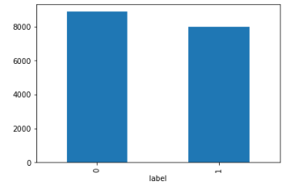
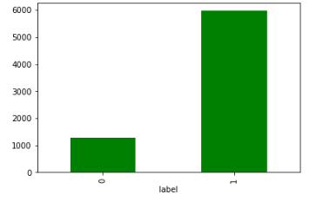
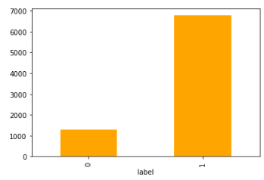
Bivariate Analysis Observation # Customers with high value of Age on cellular network in days (aon) are maximum defaulters (who have not paid their loan amount-0). # Customers with high value of Daily amount spent from main account, averaged over last 30 days (in Indonesian Rupiah) (daily_decr30) are maximum Non-defaulters (who have paid their loan amount-1). # Customers with high value of Daily amount spent from main account, averaged over last 90 days (in Indonesian Rupiah) (daily_decr90) are maximum Non-defaulters (who have paid their loan amount-1).

Slide 13
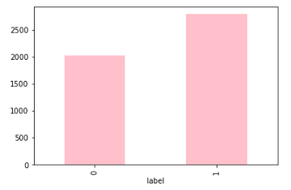
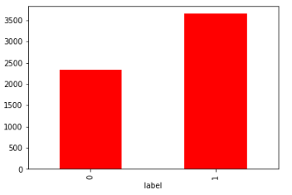
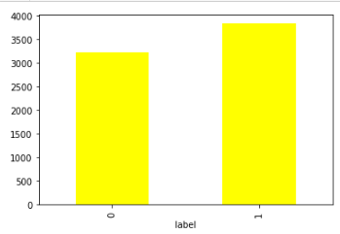
Observation # Customers with high value of Average main account balance over last 30 days(rental30) are maximum Non-defaulters (who have paid their loan amount-1). # Customers with high value of Average main account balance over last 90 days(rental90) are maximum Non-defaulters (who have paid their loan amount-1). # Customers with high Number of days till last recharge of main account (last_rech_date_ma) are maximum Non-defaulters (who have paid their loan amount-1).

Slide 14
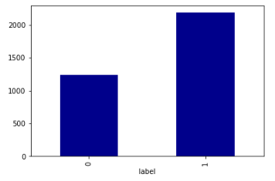
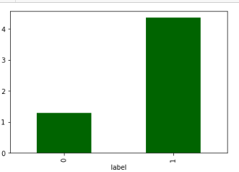
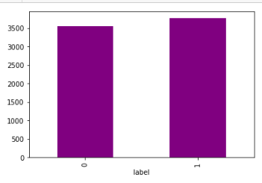
Observation # Customers with high value of Amount of last recharge of main account (in Indonesian Rupiah) (last_rech_amt_ma) are maximum Non defaulters (who have paid there loan amount-1). # Customers with high value of Number of times main account got recharged in last 30 days(cnt_ma_rech30) are maximum value count 1. It means the there is less loan defaulter. # We can see, Frequency of main account recharged in last 30 days are near to each other’s. In this who's are not defaulting loan are higher than defaulting loan. But who’s are defaulting loan being also high in count but less than not defaulting.

Slide 15
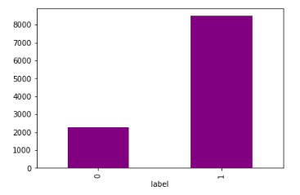
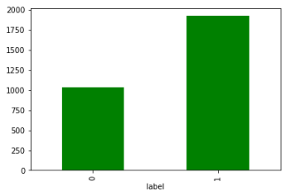
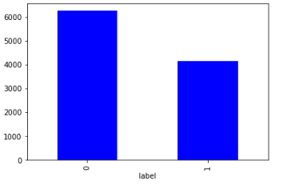
Observation # We can see, maximum customer doing their recharge at time but Total amount of recharge in main account over last 30 days (in Indonesian Rupiah) of defaulting loan is less than not defaulting loan. # Customers with high value of Median of number of recharges done in main account over last 30 days at user level (in Indonesian Rupiah) (medianamnt_ma_rech30) are maximum Non-defaulters (who have paid their loan amount-1). # Median of main account balance just before recharge in last 30 days at user level (in Indonesian Rupiah) is high in whose are loan defaulting. It is less in those are not defaulting the loan.

Slide 16
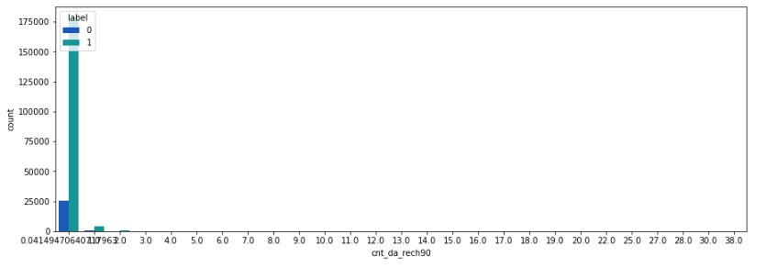
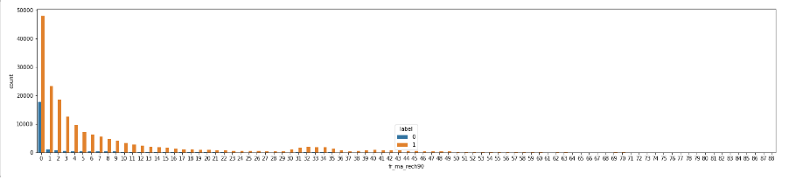
Observation # We can see there are less Frequency of main account recharged in last 90 days who’s defaulting the loan. # We can see, there are less defaulter who’s having a smaller Number of times data account got recharged in last 30 days.

Slide 17
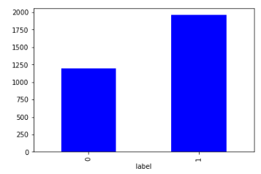
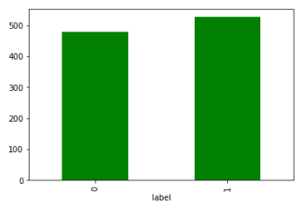
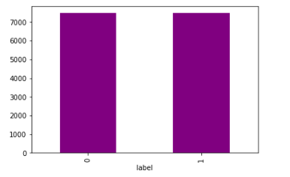
Observation # Median of number of recharges done in main account over last 90 days at user level (in Indonesian Rupiah), in this feature there are less defaulting loan. But up to 1175 the defaulting loan count. # Number of times data account got recharged in last 30 days(cnt_dat_rech30) has high loan not deflater than defaulting loan. But Who's are not defaulting loan it also in high count but little less than not defaulting count. # We can see, Frequency of data account recharged in last 30 days(fr_da_rech30) are almost same for both defaulting loan and not defaulting loan.

Slide 18
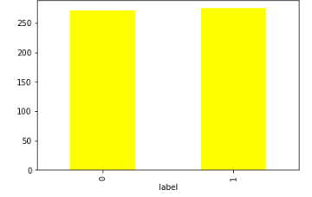
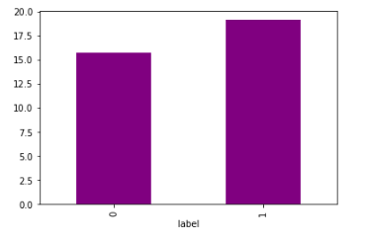
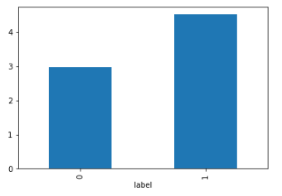
Observation # We can see maximum amount of loan taken by the user in last 30 days are almost same for both defaulting the loan and not defaulting the loan. It means that users are taking maximum loan and not paid the loan amount or defaulting the loan. # Number of loans taken by user in last 90 days is high and it also high in loan are not defaulting. But loan defaulting little lower than non-defaulting users. # Customers with high value of Average payback time in days over last 90 days(payback90) are maximum Non-defaulters (who have paid their loan amount-1).

Slide 19
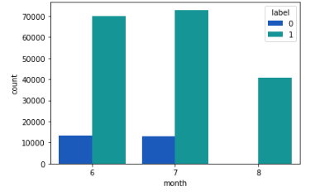
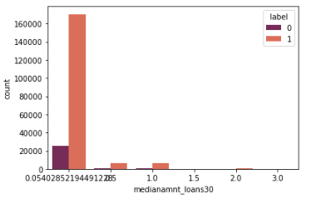
Observation # We can see, in 7- month customers are taking loan is high than 6 month and it loan defaulting also high in 7-month than 6 - month. But in 8 Month non defaulting loan are not present. it means in this month customer are not defaulting the loan. # Median of amounts of loan taken by the user in last 30 days is high in non-defaulting loan. Here are only 6 categories are given in which 0.05 is having high non defaulting customers.

Slide 20
Data cleaning steps # First step I have imported required libraries and I have imported the dataset which was in csv format. # Then I did all the statistical analysis like checking shape, nunique, value counts, info etc. # Then I did value count, in this I found that few features are having more 90% 0 values so avoiding biasness I simply drop this feature. # I found that, few features are containing 0 value so replace it with mean value. # I have also dropped Unnamed:0, msisdn and pcircle column as I found they are useless. # Next as a part of feature extraction I converted the pdate column to pyear, pmonth and pday.

Slide 21
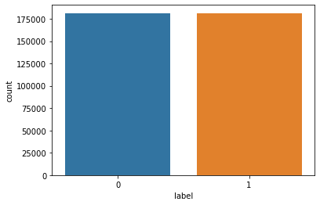
Data Balancing I have used oversampling (SMOTE) to get rid of data imbalancing. The balanced output looks like this.

Slide 22
Model Building Since Label was my target and it was a Categorical column, so this particular problem was Classification problem. And I have used Classification algorithms to build my model. By looking into the difference of accuracy score and cross validation score I found as a best model with least difference. Also to get the best model we have to run through multiple models and to avoid the confusion of overfitting we have go through cross validation. Below are the list of Classification algorithms I have used in my project. # Logistic Regression # Random Forest Classifier # Support Vector Classifier # XGBoost Classifier

Slide 23
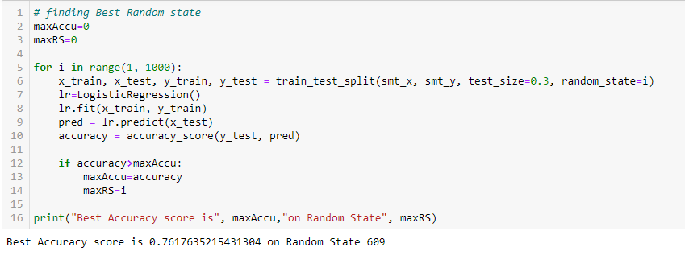
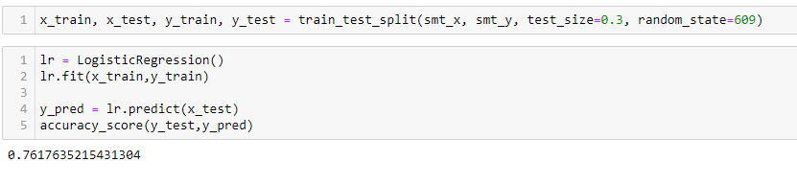
Logistic Regression: Finding Best Random State Train and Test the Model

Slide 24
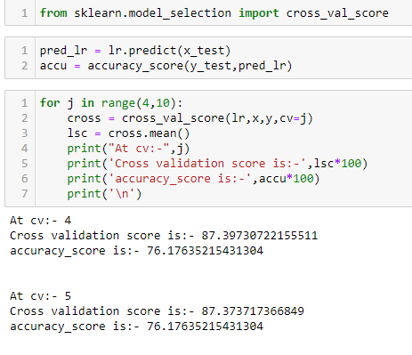
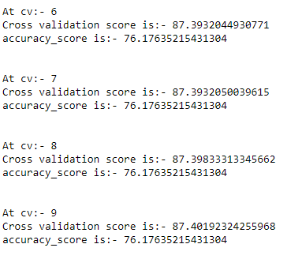
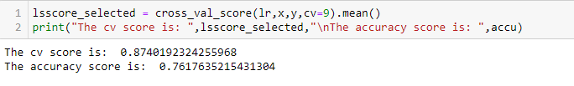
Cross Validation of the model

Slide 25
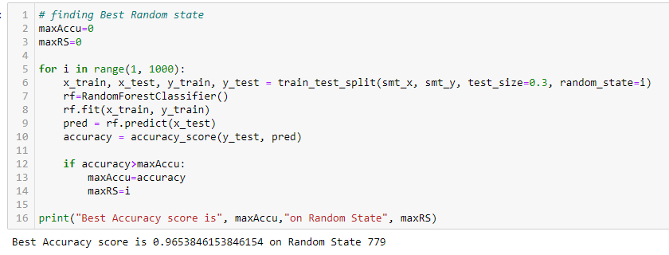
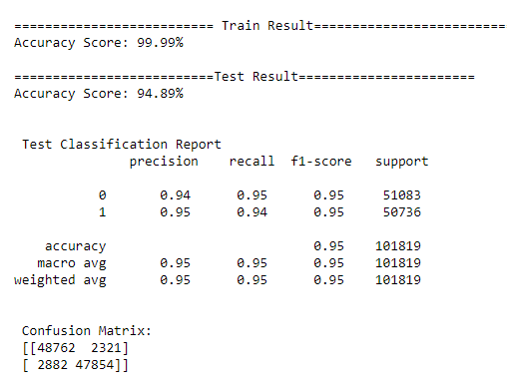
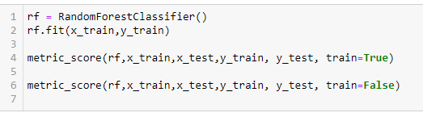
Random Forest Classifier: Finding Best Random State Train and Test the Model

Slide 26
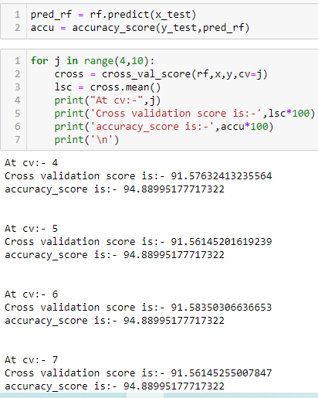
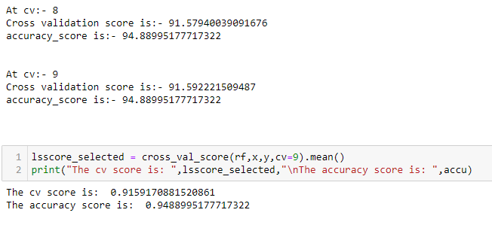
Cross Validation of the Model

Slide 27



Support Vector Classifier: Finding Best Random State Train And Test the Model

Slide 28


Cross Validation of the Model

Slide 29



XGBoost Classifier: Finding Best Random State Train and Test the Model

Slide 30








Cross Validation of the Model

Slide 31



ROC AUC Curve For Training For Testing

Slide 32




Hyperparameter Tuning

Slide 33


The Model Save and Testing

Slide 34
Conclusions Once a loan is written off, it is no longer on the books of the lender. However, the MFI’s decision to write-off the loan is often driven by prudential accounting or regulatory requirements and is not necessarily a signal that the debt has been forgiven. Therefore, the lender may continue to attempt to recover it, and so the borrower is not free from the prospect of a collections call or visit. The borrower may be barred from future borrowing from the same MFI, or (if reported to a credit bureau) other MFIs. At the microfinance level, bankruptcy is not an option. And, in most developing countries debt counseling or rehabilitation services are not available to assist defaulters. In this project report, we have used machine learning algorithms to predict the micro credit defaulters. We have mentioned the step by step procedure to analyse the dataset and finding the correlation between the features. Thus, we can select the features which are correlated to each other and are independent in nature. These feature set were then given as an input to four algorithms and a hyper parameter tunning was done to the best model and the accuracy has been improved. Hence, we calculated the performance of each model using different performance metrics and compared them based on these metrics. Then we have also saved the best model and predicted the label. It was good the predicted and actual values were almost same.

Slide 35


